Slide 1
Intro to Machine Learning for Health
CRTP Fall Term, Week 1
Matt Engelhard, Duke Biostatistics & Bioinformatics
Notes:
We will be exploring, and implementing, data science approaches poised to disrupt clinical practice
computer vision
natural language processing
We’ll be doing this from an intuitive, applications-oriented perspective
readings from the clinical literature
hands-on computational exercises designed for both coders and non-coders
lectures will be interactive, and we’ll weave in clinical applications examples
My background
- committed to interdisciplinary work

Slide 2
Course Objectives
You might not be building models, but you’ll use them. You should know:
What they can and can’t do (capabilities, limitations)
When and how much to trust their predictions (evaluation)
What’s inside the black box (interpretation, understanding)
Equip you to:
build your own models (if you wish)
design and manage data science research and/or QA/QI projects
collaborate and communicate effectively with data scientists
add rigor to model development and validation
Notes:
Data science techniques are changing healthcare
You might not be building them, but you will be using them.
Understand what they can and can’t do (capabilities)
Know how to critically evaluate (trust)
Know how to interpret (understanding)
Intuitive, applications-oriented perspective

Slide 3
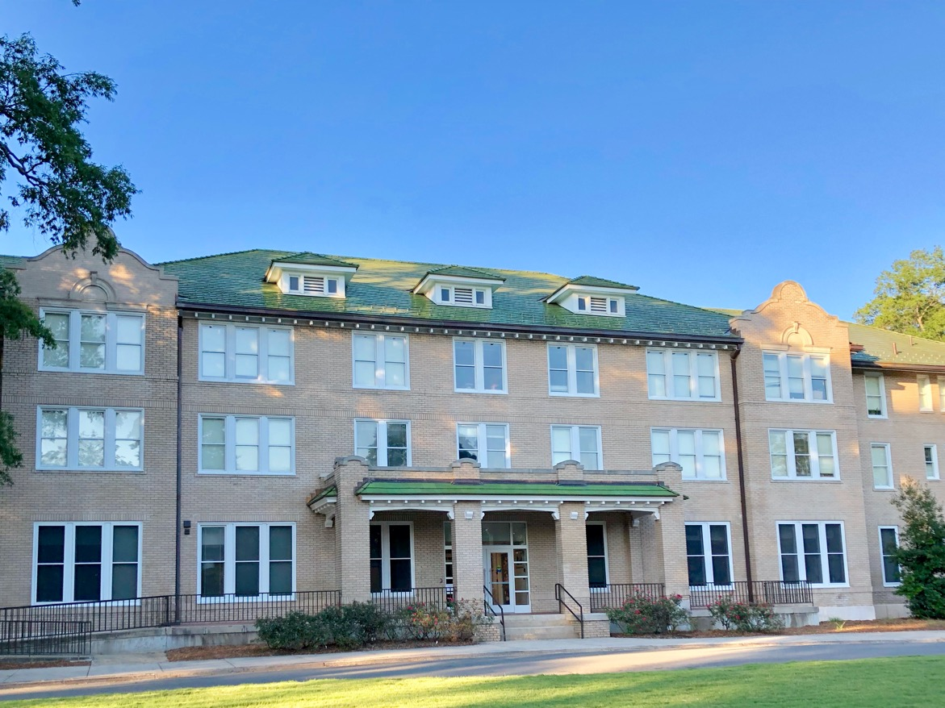
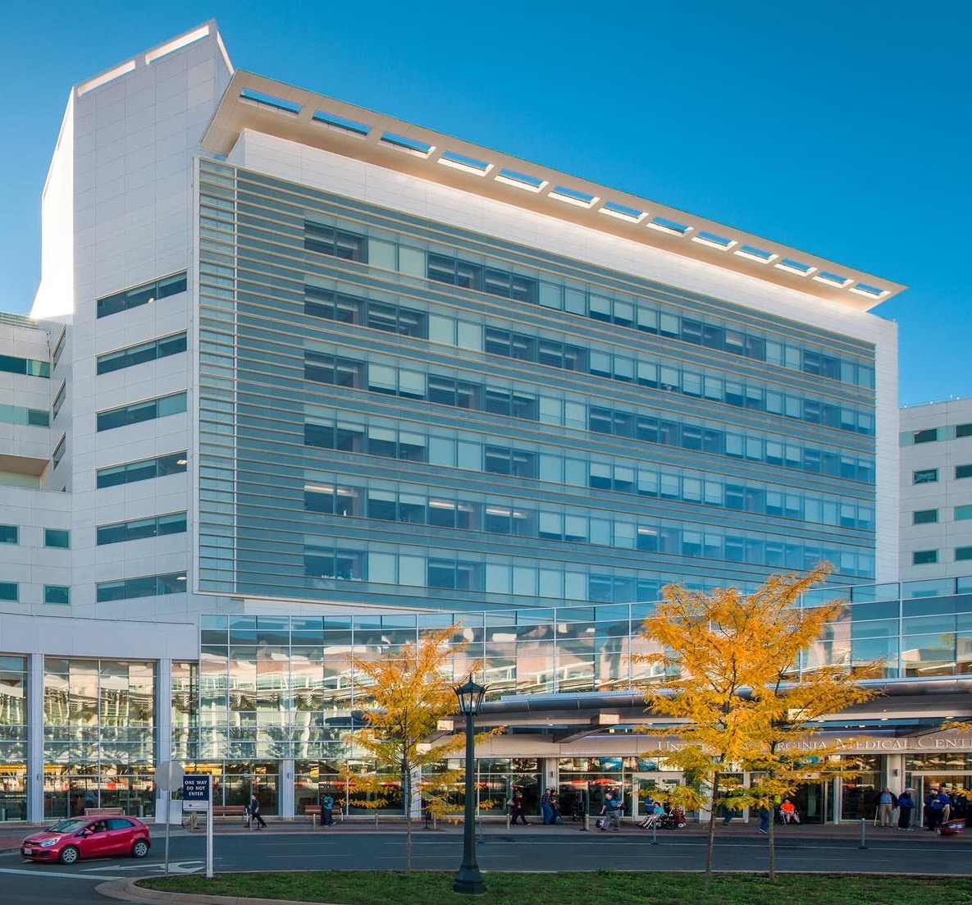
Notes:
My background
Duke undergrad
NSA
UVA
Back to Duke
Goal: get quants and providers to talk

Slide 4
Introductions!
your name
+ your role either just before CRTP or outside of CRTP
+ any other fact about yourself (e.g. a typical breakfast, last tv show you watched)
+ how you feel about the effects DS/ML/AI will have on health
(excited, worried, both, something else)

Slide 5
Course Overview
We will learn about state-of-the-art data science techniques that have changed or will change clinical practice.
How are these techniques different from what has come before?
How are they the same?
What do you need to know to use them effectively and responsibly?
I know that most of you are NOT going to be data scientists.
But you will work with data scientists, and you will have to make decisions about what models to use and how to use them. It is important to know enough to get in the weeds with the data scientists, because if applied/evaluated incorrectly, these models are certain to be unhelpful and likely to be harmful.
Notes:
Some of you will start building models
Some of you will start evaluating
All of you will learn how things can go wrong
And – I hope – how to engage in collaborative health DS

Slide 6
A Brief Tour of DS in 2023
General Application -> Biomedical Application

Slide 7
10,000-foot view of machine learning in 2023
Computer vision (self-driving)
Natural language processing (NLP) (ChatGPT)
Reinforcement learning (AlphaGo)
Each of these has high clinical relevance
ML for large, high-dimensional biomedical data
electronic health record
-omics
digital health
Notes:
3 pillars of machine learning
Computer vision
self-driving
Make dad look like a cat
NLP –
chatGPT
Certain to either save or destroy the world, depending on who you ask
RL
– smart fridge can beat a chess grandmaster
Vision is useful in clinical medicine already
NLP revolution is here
RL disruption: on the horizon
Many smaller, critical pillars: ML for large-scale clinical and biomedical data
So, let’s look at each of these 3 pillars in turn.

Slide 8
Computer Vision: Real-Time Object Detection (& segmentation)
Notes:
First pillar: computer vision
What’s happening here?
The same kind of models that can do this… can do that…

Slide 9
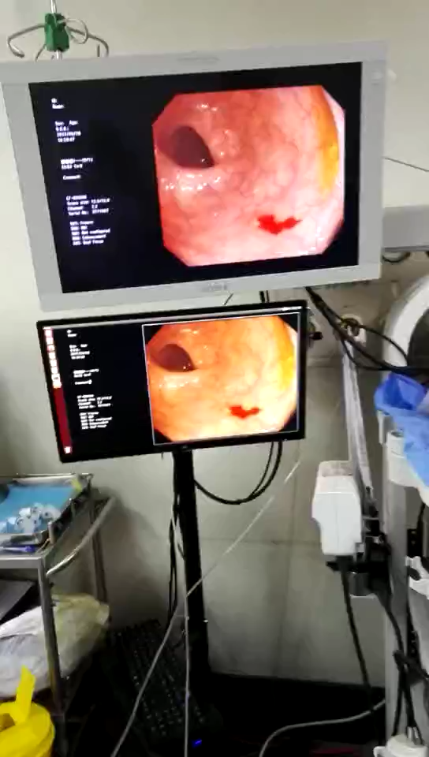
Real-time polyp detection: a second set of eyes during colonoscopy

Slide 10
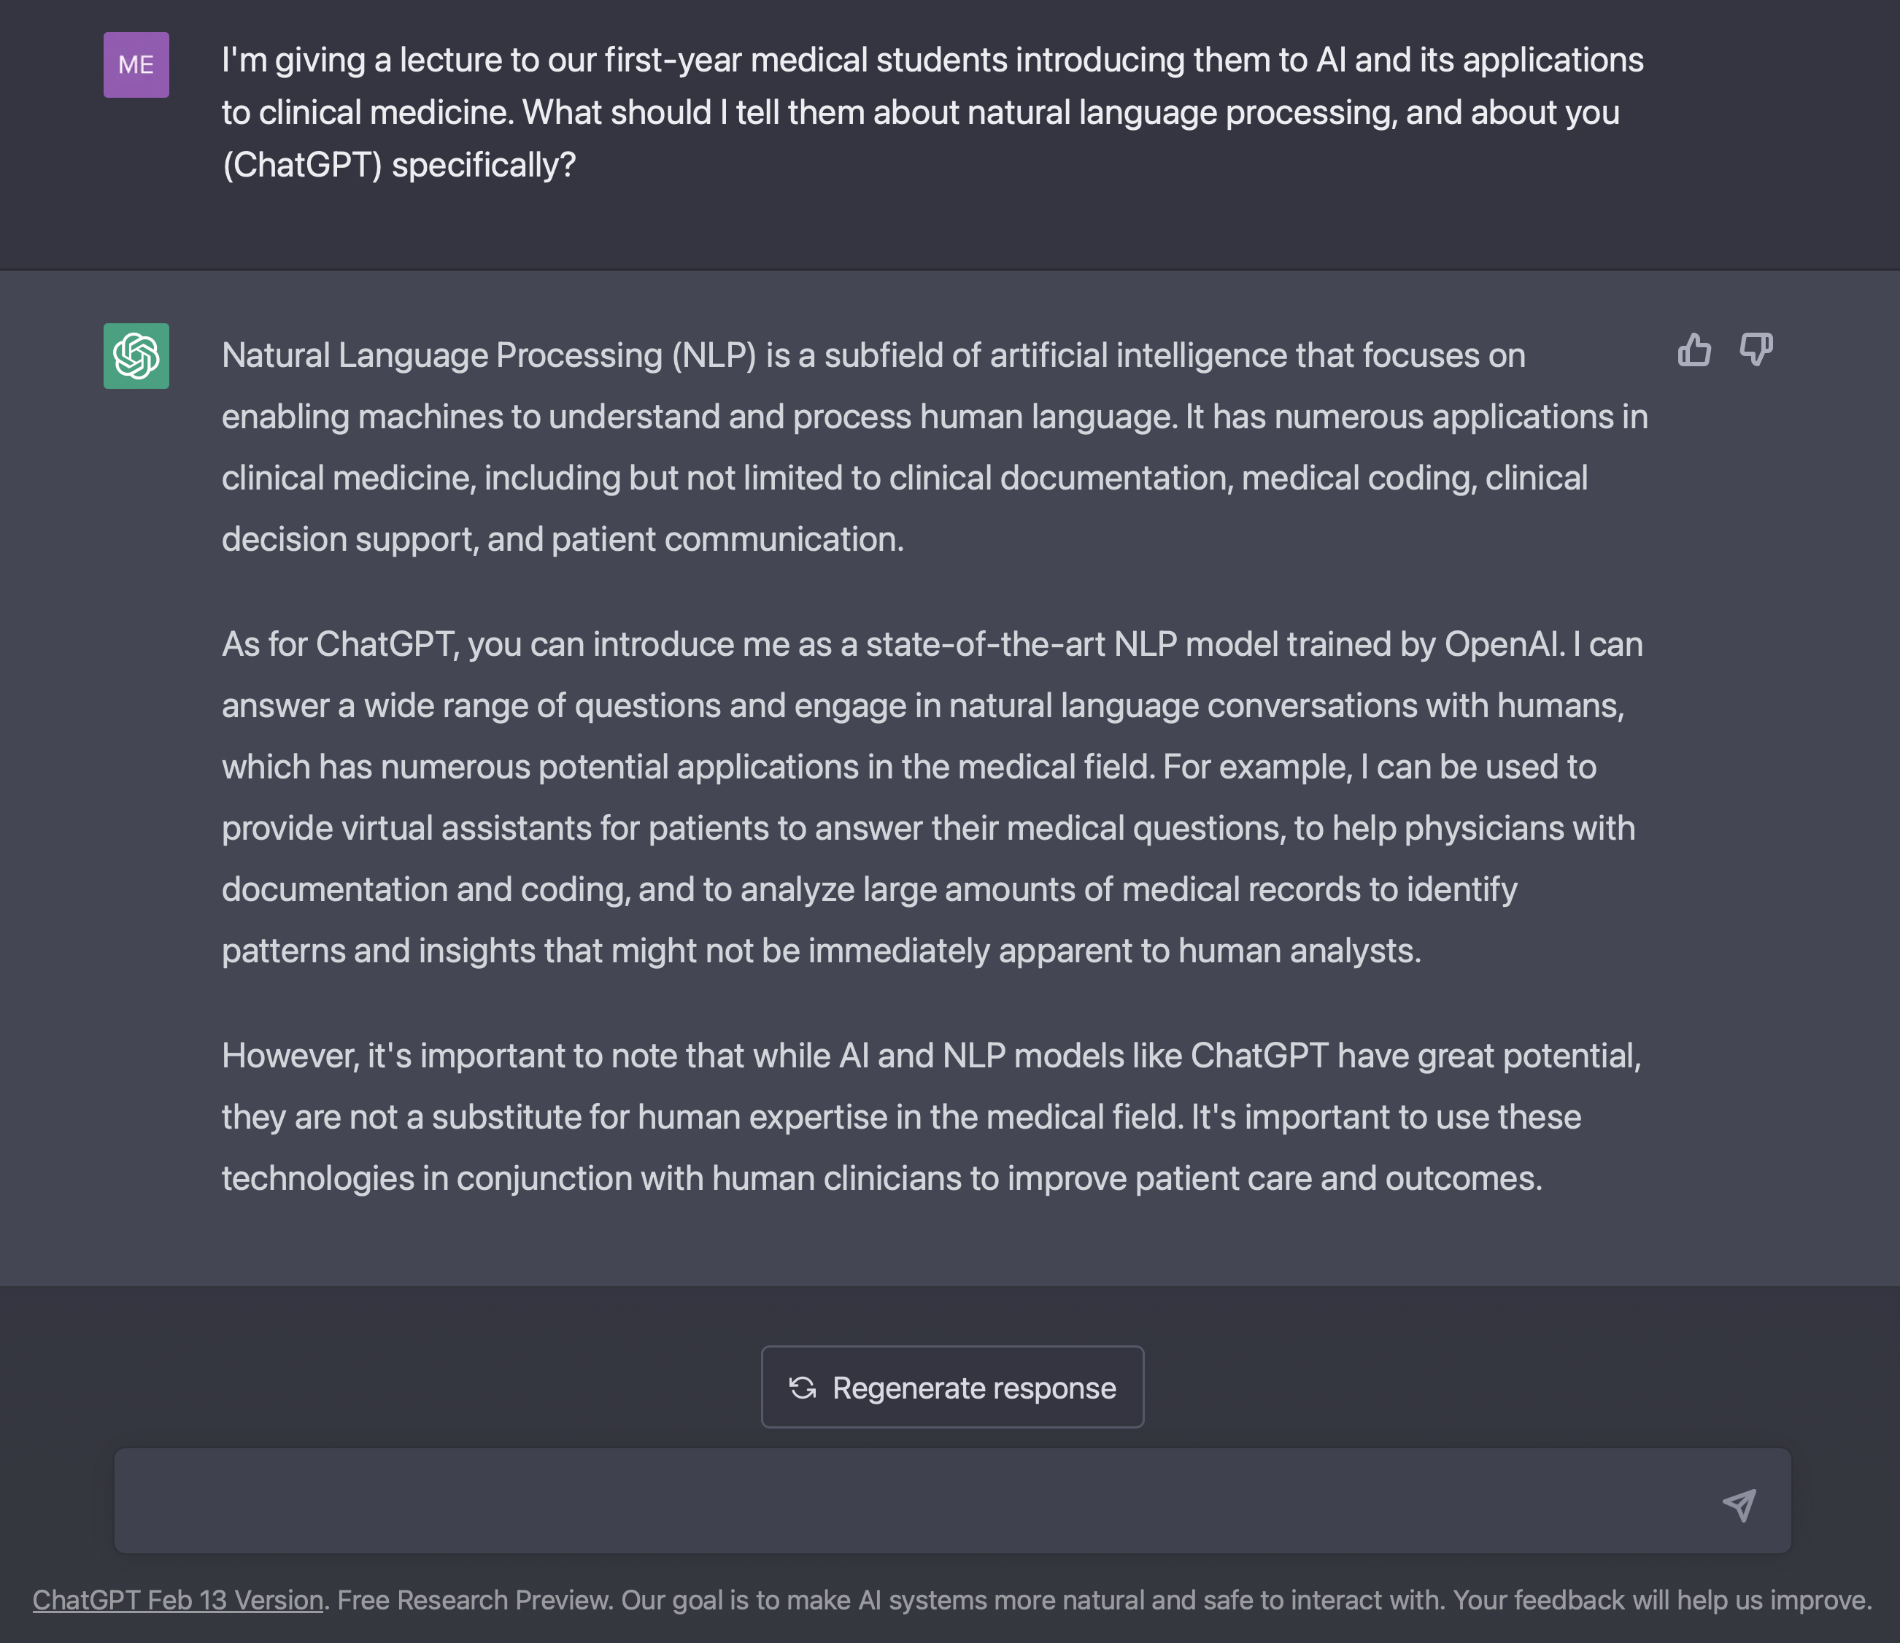
NLP: Text Generation
Notes:
2nd pillar: NLP
What can NLP do?
Well, many of you have likely already explored it yourself
Now, I would never use chatGPT to write a lecture for this group – you’re too important
But I did use it to help me design my lecture for the first-year medical students
And here’s what it told me…
And if I had asked it for more specific, detailed suggestions, it would have provided them

Slide 11
Text Generation via GPT-3 (ChatGPT precursor)
SYSTEM PROMPT (HUMAN-WRITTEN)
A train carriage containing controlled nuclear materials was stolen in Cincinnati today. Its whereabouts are unknown.
MODEL COMPLETION (MACHINE-WRITTEN, FIRST TRY)
The incident occurred on the downtown train line, which runs from Covington and Ashland stations.
In an email to Ohio news outlets, the U.S. Department of Energy said it is working with the Federal Railroad Administration to find the thief.
“The theft of this nuclear material will have significant negative consequences on public and environmental health, our workforce and the economy of our nation,” said Tom Hicks, the U.S. Energy Secretary, in a statement. “Our top priority is to secure the theft and ensure it doesn’t happen again.”
The stolen material was taken from the University of Cincinnati’s Research Triangle Park nuclear research site, according to a news release from Department officials.
The Nuclear Regulatory Commission did not immediately release any information.
According to the release, the U.S. Department of Energy’s Office of Nuclear Material Safety and Security is leading that team’s investigation.
“The safety of people, the environment and the nation’s nuclear stockpile is our highest priority,” Hicks said. “We will get to the bottom of this and make no excuses.
“Better Language Models and Their Implications”
2/14/19
OpenAI
Notes:
Writing has been on the wall since about 2018-2019…
Generative models based on transformer architecture and trained on 8 million webpages

Slide 12
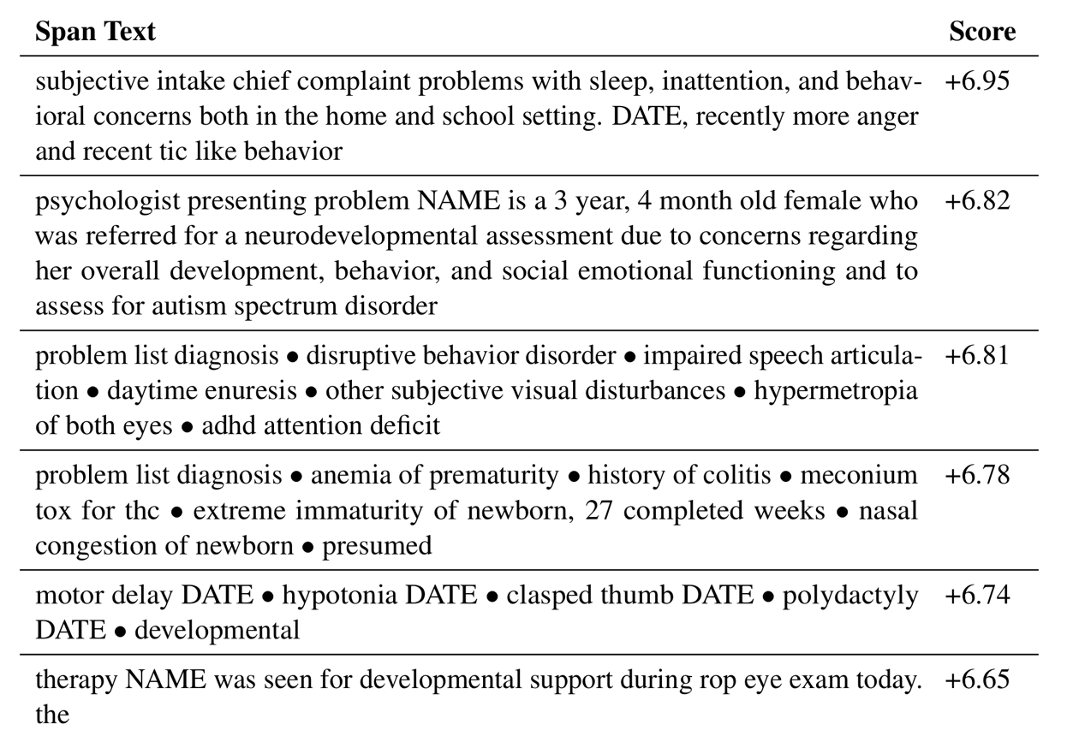
Natural Language Processing: Find Predictive Text in Notes
Passage (from note) | Change in predicted autism dx log-odds
Developmental and behavioral concerns are highly predictive
Premature birth and perinatal complications are also highly predictive
Subramanian V, Engelhard MM, Berchuck SI, Chen L, Carin L. SpanPredict: Extraction of Predictive Document Spans with Neural Attention. Submitted to NAACL.
Notes:
What can NLP do in medicine?
imagine…
summarize medical knowledge
extract info from pt charts
create template responses / notes
But I want to point out one application from our work…

Slide 13
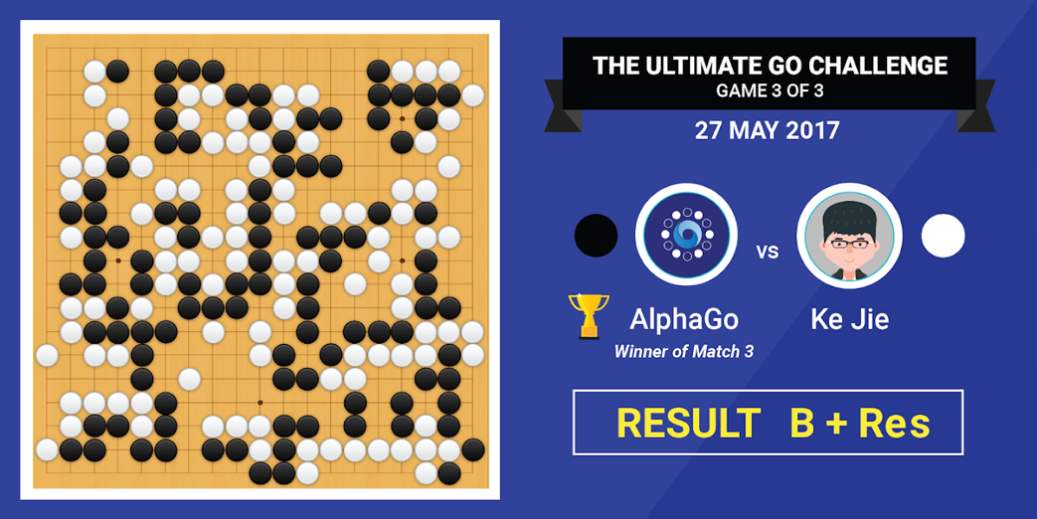
Reinforcement Learning: goal-directed sequential decision-making
Notes:
On to Pillar 3: reinforcement learning
- stick figure
- Limited control of motor function
- running late to pick up his kid from daycare?
- agent
- goal (get to the daycare on time)
- Available actions: some help (e.g. stepping forward), others not so much (e.g. pumping his fist repeatedly)
- try things; figure out which actions get him to the goal
It’s the same with chess
“Goal-directed sequential decision-making”
What moves help alphaGo win the game?
What moves hurt it?

Slide 14
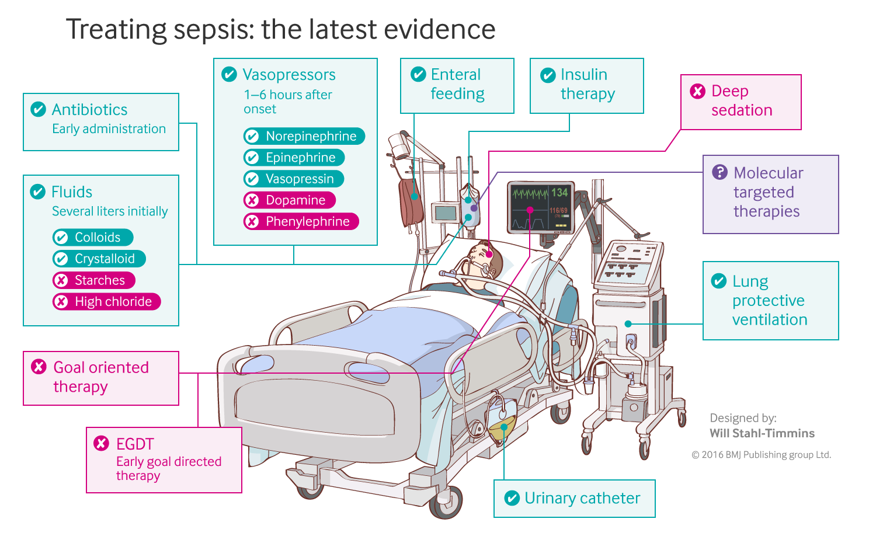
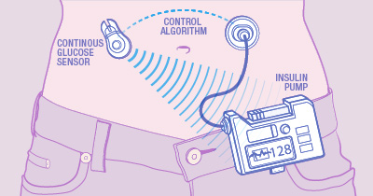
Reinforcement Learning in Medicine
Closed-loop blood glucose control
(“artificial pancreas”)
Fluid and vasopressor administration
for sepsis treatment
https://www.mayo.edu/research/labs/artificial-pancreas/overview
Gotts JE, Matthay MA. Sepsis: pathophysiology and clinical management. bmj. 2016 May 23;353(i1585).
Notes:
Goal directed, sequential decision-making in medicine?
Administer insulin to maintain normoglycemia
Give fluid and vasopressor to keep pt alive

Slide 15
All of these have, at their core, a predictive model
y, associated value or label
x, data/features for a subject or patient
End goal: predict y from x
Notes:
But at the heart of all these systems: a predictive model.
Equation / algorithm
You give it x, it predicts y
A prediction machine.
That learns from data

Slide 16
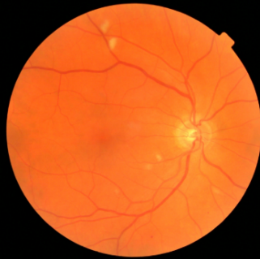
Computer Vision: prediction via convolutional neural network
y, referrable diabetic retinopathy
x, retinal image
End goal: predict y from x
Notes:
computer vision:
Image to image label

Slide 17
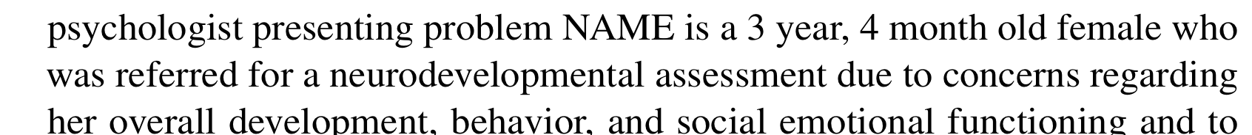
Natural Language Processing: prediction via stacked attention networks
y, autism risk
x, clinical note
End goal: predict y from x
Notes:
NLP
Convert text to numbers
Then predict.

Slide 18

Reinforcement Learning: state to action predictions via multilayer perceptron
y, next move
x, Go board state
End goal: predict y from x
Notes:
RL
Predict best action from state of the board
stick figure:
Walk around the obstacle? or
Slam your head into it while pumping your fist
What’s the “state of the board”?
Often the patient’s physiologic status.

Slide 19
APACHE III: A model for predicting ICU mortality
WBC Count
Respiratory Rate
Creatinine
Mean BP
Hematocrit
Pulse Rate
Temperature
Survival
Age
y, associated value or label
x, data/features for a subject or patient
End goal: predict odds of hospital mortality
Notes:
often x is a fairly simple set of features
predictive models like this are NOT new, AT ALL, in medicine
Here: predict mortality from clinical vars on admission

Slide 20
Traditional models (e.g. logistic regression) tend to work well for data like this.
Age
WBC Count
Respiratory Rate
Creatinine
Mean BP
Hematocrit
Pulse Rate
Temperature
Survival
y, associated value or label
x, data/features for a subject or patient
End goal: predict odds of hospital mortality
Notes:
In this setting, simple models work well
“use the simplest model that gets the job done” (unpack)

Slide 21
As the complexity of the underlying data increases, so too does the probable value added by machine learning
image analysis
(radiology, pathology)
fusion of multiple modalities
McKinney et al.
natural language processing (clinical notes)
Craik et al.
clinical and digital health time series
Christodoulou et al.
value added by machine learning
structured EHR or registry data
S. Huang et al.
curated clinical datasets
K. Huang et al.
Khera et al.
data complexity
Simple models based on clinical variables remain highly relevant
*Use the simplest model that gets the job done*
Notes:
Other times simple will not work
What do we mean by complexity?
Spatial, temporal, sequential structure
Underlying index set
More on this later

Slide 22
Course Logistics
Let’s take a look at the website
Questions & discussion about course requirements, materials, or activities
Contact me: m.engelhard@duke.edu

